Slide 1
Introduction to Assembly language Programming
Unit 2

Slide 2
Mnemonics
Mnemonics is a Greek word called mindful(mind aid).
Manufacturer of microprocessor has devised a symbolic code for each instruction called mnemonics.
E.g 0011 1100 in 8085 is INR A.

Slide 3
Assembly language and High level languages
Each device has its own set of instruction depending on design of CPU.
To communicate with computer one must give instructions in binary form.
It is difficult for most people to write programs in sets of 0’s and 1’s.
So, microprocessor manufacturer introduce English like words to represents the binary instruction of machine.

Slide 4
Programmer can write programs called assembly language programs using mnemonics.
Assembly language program are non transferrable from one machine to other.
Programming languages are of two types-
low level language
Machine language
Assembly language
High level language (machine independent like BASIC,FORTAN)

Slide 5
High level languages are machine independent and are transferrable.
Machine and assembly languages are microprocessor specific
Since a program can be written in high level or assembly language but microprocessor only understand binary so it must be translated to binary code or machine code
The program written in assembly languages are translated into a binary code by using a program called an assembler.

Slide 6
Programming with Intel 8085 microprocessor

Slide 7
Introduction to assembly language programming
Assembly language use two three or four letter mnemonics to represent each instruction type.
Low level assembly language is designed for a specific family of processor
The symbolic instruction of assembly language are assembled into machine language
Assembly language makes writing program easier than machine code.
Later it is translated into machine language and can be loaded into memory and run.

Slide 8
Advantage of assembly language
Requires less memory and execution time than high level language.
Gives programmer the ability to perform highly technical tasks.
Provides more control over handling particular hardware requirement.
Generates smaller and compact executable modules.

Slide 9
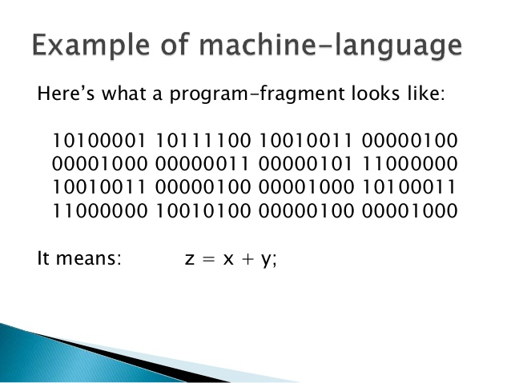

Slide 10
Typical Format of Assembly Language Instruction
Label | Opcode Field | Operand Field | Comments
Next: | ADD | AL,07H | ;Add correction factor
ADD R1, R0
Here R0 is source Register & R1 is destination register
Instruction adds contents of R0 with the contents of R1 and stores result in R1 register.
8085 Can handle maximum of 256 instructions.

Slide 11
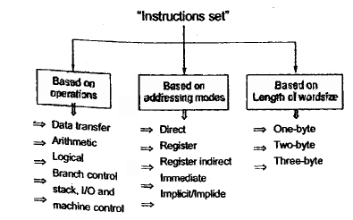
Classification of Instruction sets

Slide 12
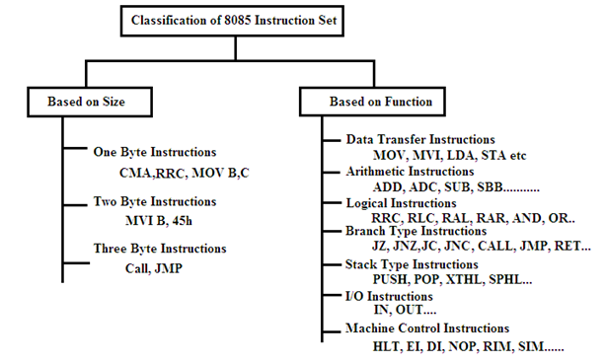
Classification of 8085 Instruction sets

Slide 13
Instruction format
Depending on the number of address specified, the Instruction format can be classified into three categories:
One Byte Instruction:
Here one byte will be operand.
E.g MOV A,B
Two Byte Instruction:
First byte will be opcode and second byte will be operand/data.
E.g MVI A, data
Three Byte Instruction:
First byte opcode and second , third byte will be operand/data.
E.g LXI B,4050H

Slide 14
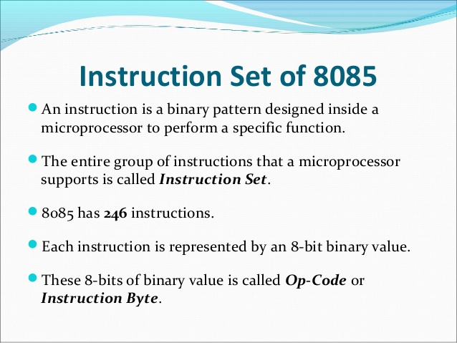

Slide 15
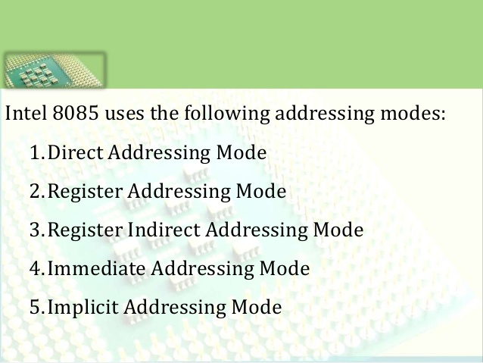

Slide 16
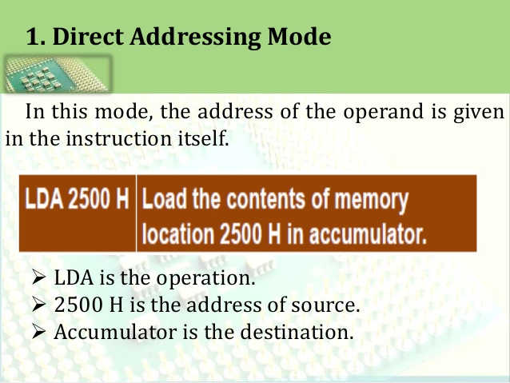

Slide 17
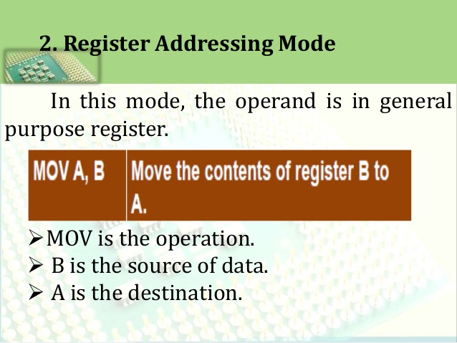

Slide 18
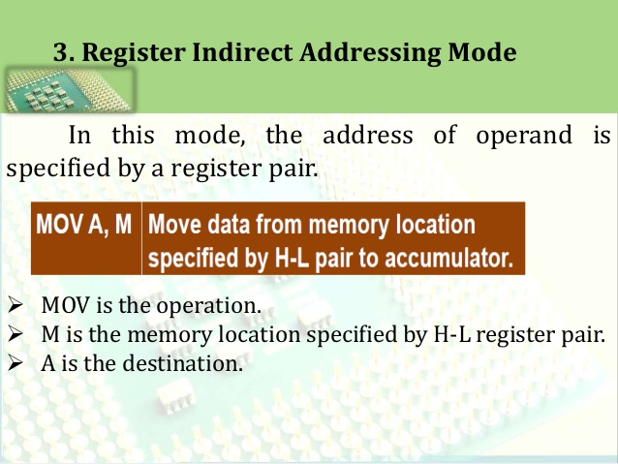

Slide 19
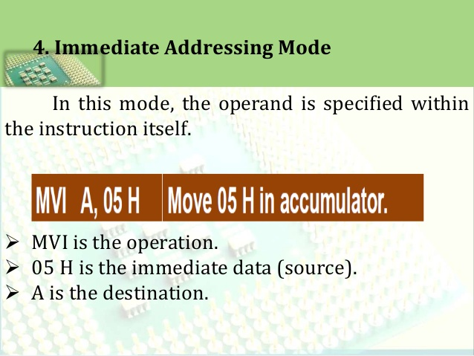

Slide 20
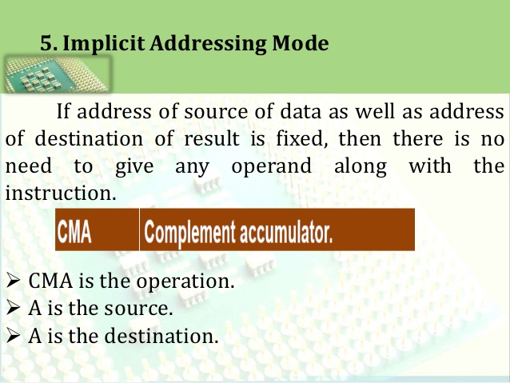

Slide 21
Writing or Assembling a program
Step 1: Read problem carefully
Step 2: Break it down into small steps
Step 3: Represent these small steps in a possible sequence with a flow chart
Step 4: Translate the block of flowchart into appropriate mnemonic instructions
Step 5: Translate mnemonic into machine code
Step 6: Enter the machine code in memory and execute
Step 7: Start troubleshooting(debugging a program)

Slide 22
Executing a program
The machine code can be loaded into read write memory starting with some memory address
The execution of program can be done in two ways
1. The first is to execute entire code by pressing execute key
2. Second is to use the single step key. It executes one instruction at time. By using examine register key we can observe the contents of registers and flags after each instruction being executed.

Slide 23
Debugging a program
Debugging binary code is much more difficult and cumbersome.
Essentially we search carefully for the errors in the program logic, machine codes and execution
The debugging process can be divided into two parts,
Static Debugging: Visual Inspection of a flowchart and machine code
Dynamic Debugging: observing output or register contents following a execution of each instruction (Single step technique) or Group of Instructions (Breakpoint Technique)

Slide 24
Developing Counters and Time Delay Routines
Designing counter is a frequent programming application.
Counters are used to keep track of event.
Time delays are important to set up reasonably accurate timing between two events.
Process of designing counters and time delay using software instructions is more flexible and less time consuming than design process using hardware.

Slide 25
Counter
A counter is designed simply by loading an appropriate number into one register and using INR(increment by 1) and DCR (decrement by 1) instructions.
A loop is established to update a the count and each count is checked whether it has reached final number. If not, loop is repeated.
Drawback of such counter is counting perform at very high speed that only last count is observed.
To observe counting time delay between count must be used.

Slide 26
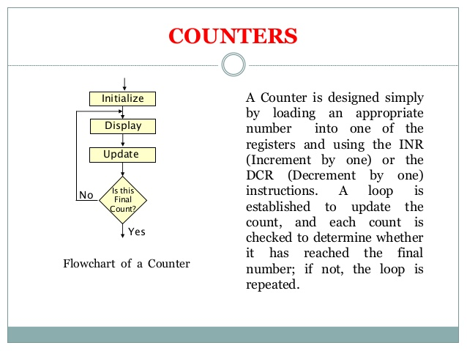
Counter

Slide 27
Time delay
Designing Time delay is similar to that used to set up counter.
The register is loaded with number depending on time delay required.
And register is decremented until it reaches zero by setting up loop with conditional jump instruction.
The loop causes delay depending on clock period of system.

Slide 28
